Slide 1
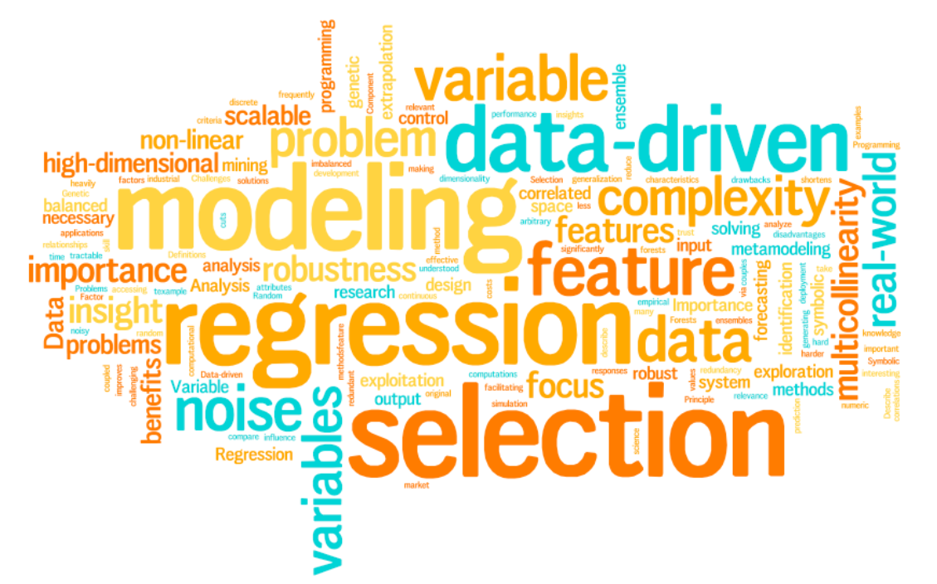
Capstone:
Customer churn Analysis
Mohammad Nasirizadeh

Slide 2

Project Milestones
EDA
Identification of variables and data types
Missing value treatment
Outlier treatment
Variable transformations
...
Exploratory Data Analysis
Data
pre-processing
Modeling & Conclusion
Supervised or unsupervised
Regression or classification
Optimization
Evaluation
Conclusion
Pre-processing
Correlation Analysis
Dimensionality Reduction
Feature Engineering
…
Predictive modeling
&
Conclusion

Slide 3





Quick Review
Tenure
Numerical Variables
Monthly Charges
Total Charges
Exploratory Data Analysis
Gender
Telco Customer Churn
Senior Citizen
Binary Variables
(YES/NO)
Partner
Dependents
Phone Services
7043 observation
21 features
Data
pre-processing
Paperless Billing
Multiple Lines
Online Backup
Streaming Movies
Streaming TV
Categorial Variables
Contract
Internet Services
Payment Method
Technical Support
Online Security
Device Protection
Churn
Target
Not Churn

Slide 4
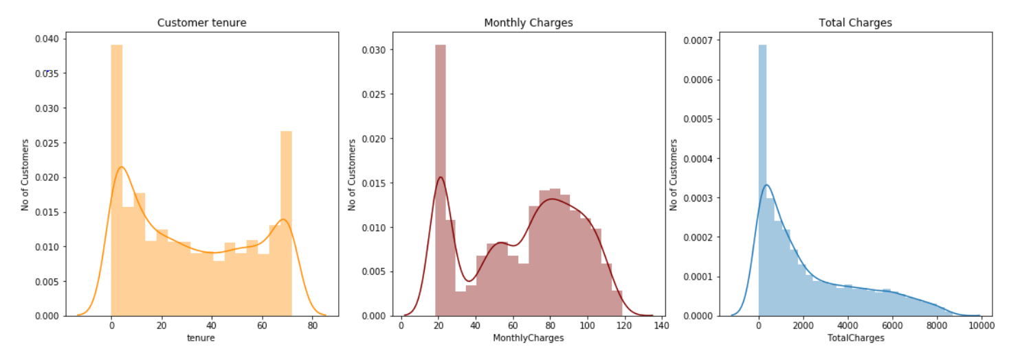
Data Pre-processing
Exploratory Data Analysis
from sklearn.preprocessing import StandardScaler
Scaling the numerical variables
Data
pre-processing
from sklearn.preprocessing import LabelEncoder
Label encoding for Binary columns
Predictive modeling
&
Conclusion
import pandas as pd
creating a dataset to combine pre-processed variables by pd.concat method
pd.get_dummies techniques for categorical columns
7043 observation
19 features
7043 observation
39 features

Slide 5


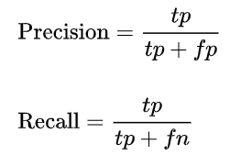

Predictive Modeling
OBJECT OF THE PROJECT
Churn(1)
No-Churn(0)
Predict Churn(1)
Predict No-Churn(0)
Predict No-Churn(0)
Predict Churn(1)
TP
FN
TN
FP
Accuracy
Precision
Recall (Sensitivity)
F1 Score
Receiver Operating Curve (ROC)
Area under the Curve (AUC)
from sklearn.metrics import confusion_matrix
There are the different types of precision metrics used in evaluating the performance of the prediction models
 | Predicted no-churn=0 | Predicted churn=1
Actual no-churn=0 | TN | FP
Actual churn=1 | FN | TP
from sklearn.metrics import metrics accuracy_score,precision_score,recall_score,f1_score
from sklearn.metrics import classification_report
from sklearn.metrics import mean_squared_error
import sklearn.metrics as metrics
from sklearn.metrics import roc_curve
from sklearn.metrics import roc_auc_score
https://en.wikipedia.org/wiki/Precision_and_recall

Slide 6

Workflow for the project
Random Forrest
Recursive Feature Elimination (RFE)
…
Features Selection
with an unbalanced dataset, machine learning models can be biased in favor of the majority class i.e. no churn as opposed to the minority class i.e. churn. Given
split the dataset into train and test set.
is a feature selection method that fits a model and removes the weakest feature (or features) until the specified number of features is reached. Features are ranked by the model’s coef_ or
feature_importances_
attributes .
Initializing models
10-fols cross validation
from sklearn.feature_selection import RFE
Synthetic Minority Oversampling Technique (SMOTE)
Ensemble Method ( Gradient Boosting)
import xgboost as xgb
Grid search to derive the optimal model
from imblearn.over_sampling import SMOTE
fit the models based on best Hypermeters
logreg = LogisticRegression( )
DT = DecisionTreeClassifier( )
rfc = RandomForestClassifier( )
knn = KNeighborsClassifier( )
svm = svm.svc( )
precision
recall
F1-Score
AUC
Conclusion

Slide 7
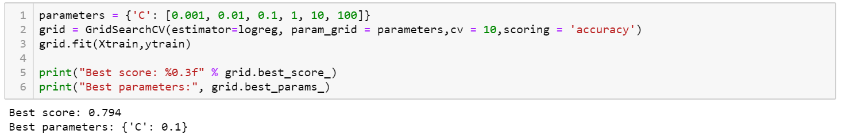
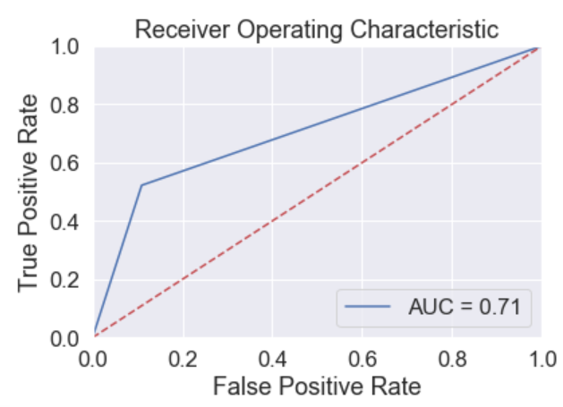
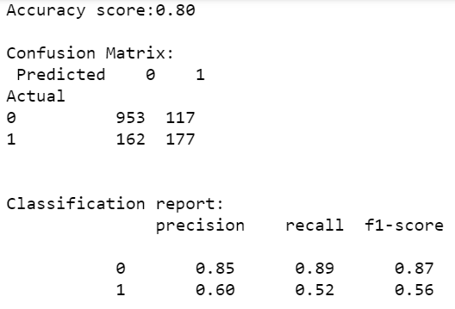
Logistic Regression (Base)

Slide 8
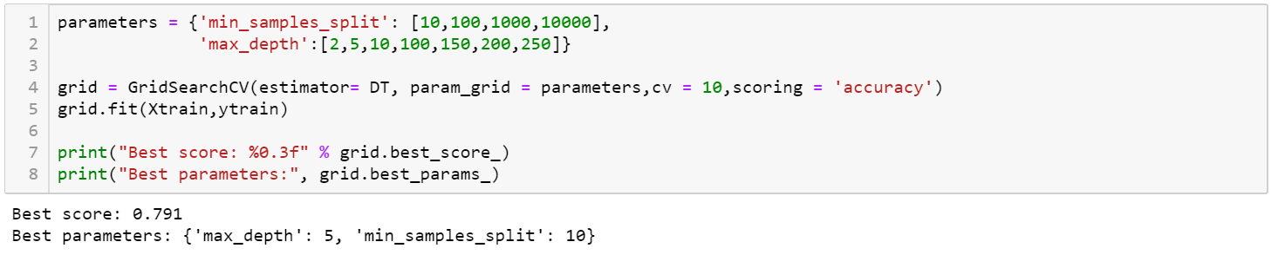
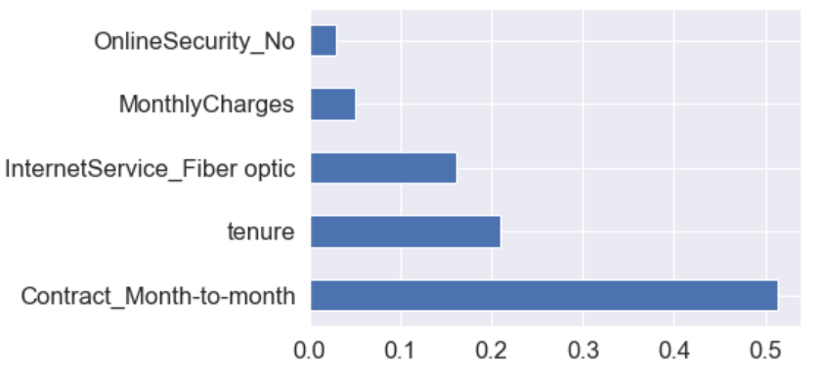
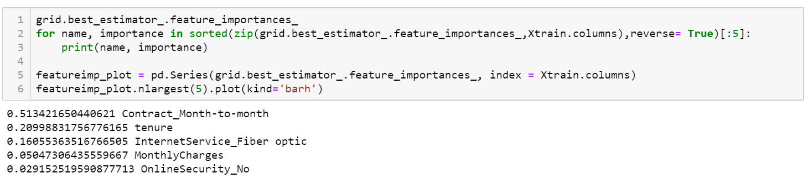
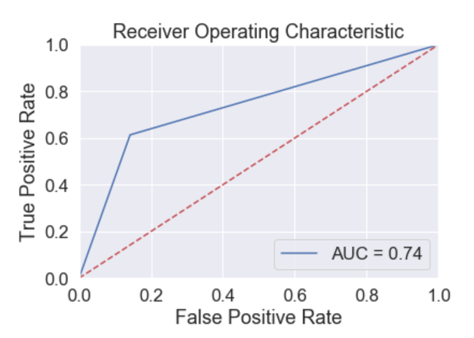
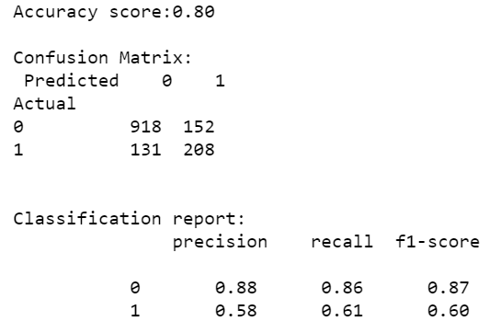
Decision Tree Classification

Slide 9
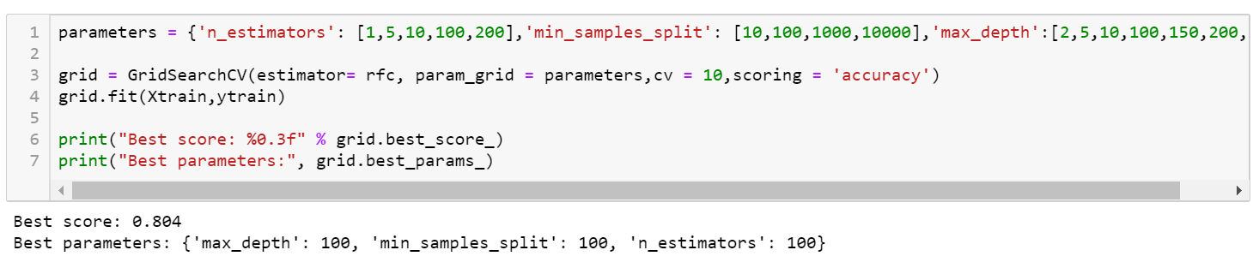
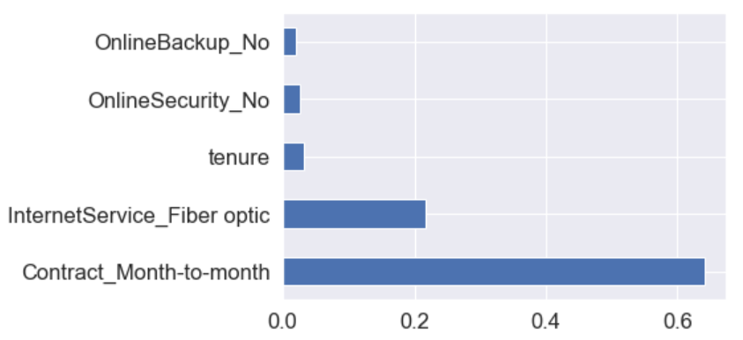
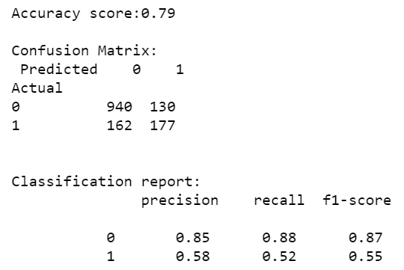
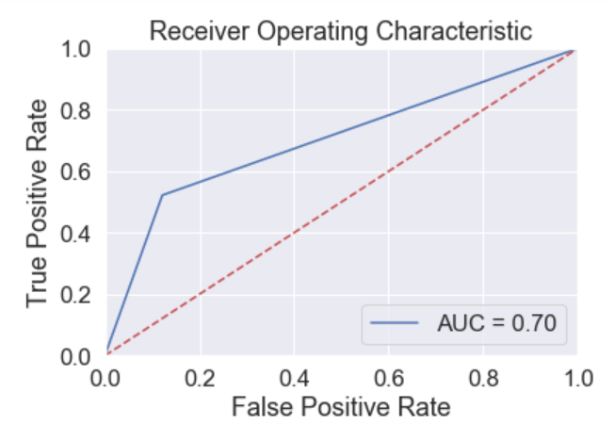
Random Forrest Model

Slide 10
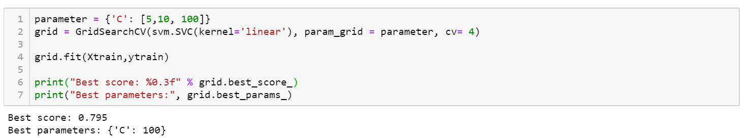
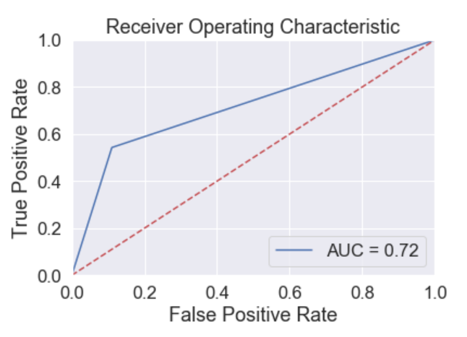
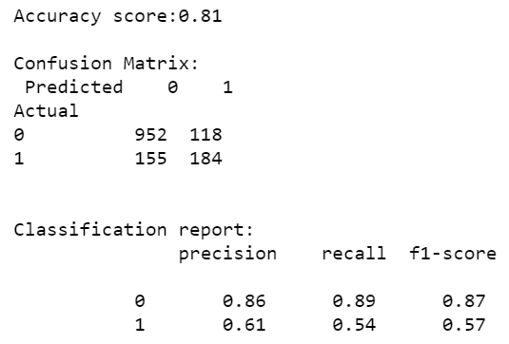
SVC Classification Model

Slide 11

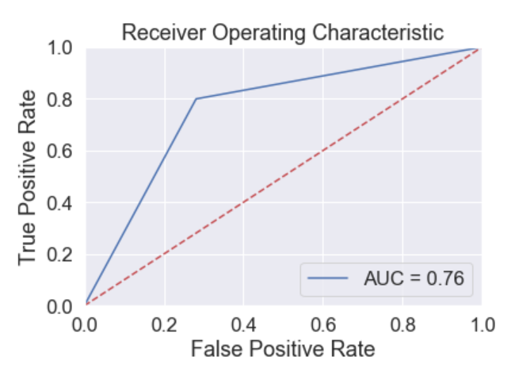
Conclusion
1. Variables such as contract type, status of online security, method of internet service provided, availability status of technical support and tenure are among the top 5 variables in the predictive analysis.
2. Precision is greater than recall. The f1-score ranges between 0.55 and 0.62 for the 'churn' class. It is the highest for decision tree model.
3. he AUC score ranges between 0.70 and 0.74. and the optimal decision tree is the best model.
SMOTE
SMOTE has reduced the gap between precision and recall for the 'churn' class. Precision still remains higher than recall for the 'churn class’.
The AUC score is now between 0.72 and 0.77. The AUC score increased for the logistic Regression to 0.77.

Slide 12
THANK YOU!

